Slide 1
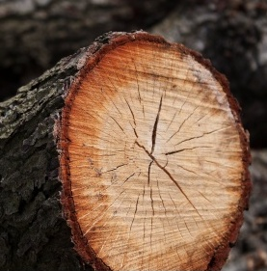
Timber
Definition:
Timber denotes wood which is suitable for building or carpentry and for various engineering and other purposes.

Slide 2
Classification of trees
Trees
Exogenous
Conifers
Deciduous
Endogenous

Slide 3
TYPES OF TREES
Trees are classified into two groups . 1. Endogenous trees:
The trees which grow inwards in longitudinal fibrous mass are called endogenous trees.
2. Exogenous tress :
The trees which grow outwards across horizontal section of stem are called exogenous trees. These trees are only fit for engineering construction.

Slide 4
Exogenous trees
Exogenous trees are again subdivided in to two types. Conifers or Evergreen:
They give soft wood.
They have pointed leaves.
Examples:
Deodar
Pine
Chir
Kail,etc
Deciduous or Broad leaf Trees:
These have hard wood.
These have broad leaves.
Examples:
Teak
Sal
Shisham, etc.

Slide 5
Comparison of softwood and hard wood
S.No. | Item | Soft woods | Hard woods
1. 2. 3. 4. 5. 6. | Annual Rings Color Density Fire resistance Weight Strength | Distinct Light Low Poor Light strong for direct pull & weak for equal resisting thrust | Indistinct Dark High More Heavy strong for resisting tension, compression & shear

Slide 6
Structure of tree
From the visibility aspect, the structure of a tree can be divided into two categories
1.Macro structure
2. Micro structure

Slide 7
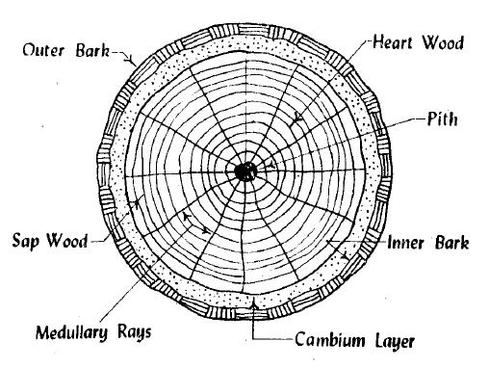
Macro structure
The structure of wood visible to the naked eye or at a small magnification is called macro structure. The following figure shows the macro structure of exogenous tree.

Slide 8
Macro structure
(a) Pith: The innermost central portion or core of the tree is called pith or medulla.
(b) Heart wood: The inner annual rings surrounding the pith is known as heart wood.
(c) Sap wood: The cuter annual rings between heart wood and cambium layer is known as sap wood.
(d) Cambium layer: Thin layer of sap between sap wood and inner bark is known as cambium layer.

Slide 9
Macro structure
(e)Inner bark: The inner skin or layer covering the cambium layer is known as inner bark.
(f) Outer Bark: The outer skin or cover of the tree is known as outer bark. (g) Medullary rays: The thin radial fibers extending from pith to cambium layer are known as medullary rays.

Slide 10
Micro structure
The structure of wood apparent only at great magnifications is called micro structure.
Conductive cells
Mechanical cells
Storage cells

Slide 11
Characteristics of good timbers
Appearance: A freshly cut surface of timber should exhibit hard and of shining appearance.
Color: A color should preferably be dark
Defects: A good timber should be free from series defects such as knots, flaws, shakes etc Durability: A good timber should be durable and capable of resisting the action of fungi, insects, chemicals, physical agencies, and mechanical agencies.

Slide 12
Characteristics of good timbers
Elasticity: The timber returns to its original shape when load causing its deformation is removed.
Fire resistance: A dense wood offers good resistance to fire.
Hardness: A good timber should be hard.
Mechanical wear: A good timber should not deteriorate easily due to mechanical wear or abrasion.

Slide 13
Characteristics of good timbers
Shape: A good timber should be capable of retaining its shape during conversion or seasoning
Smell: A good timber should have sweet smell. Unpleasant smell indicates decayed timber
Sound: A good timber should give a clear ringing sound when struck
Strength: A good timber should be sufficiently strong for working as structural member.

Slide 14
Characteristics of good timbers
Structure: The structure should be uniform.
Toughness: A good timber should be tough (i.e.) capable of offering resistance to shocks due to vibration.
Water permeability: A good timber should have low water permeability, which is measured by the quantity of water filtered through unit surface area of specimen of wood.

Slide 15
Characteristics of good timbers
Weight: The timber with heavy weight is considered to be sound and strong.
Working conditions: Timber should be easily workable. It should not clog the teeth of saw.

Slide 16
SEASONING OF TIMBER
As fresh timber which is obtained from trees contains about 30 to 40 % sap or moisture. This sap is very harmful for the life of a timber. Therefore, it is necessary to remove that sap by applying some special methods. All those methods which are used for removing the sap from timber are collectively termed as seasoning of timber.

Slide 17
Advantages of seasoned timber
It has reduced weight,
It is strong and durable,
It has resistance to decay or rot,
It takes high polish,
It is easier to work,
Its life is more.

Slide 18
Types of Timber Seasoning
The main types of timber seasoning are as under.
Natural Seasoning
Artificial Seasoning
(a)Kiln Seasoning,
(b) Chemical Seasoning,
(c) Electric Seasoning,
(3) Water Seasoning

Slide 19
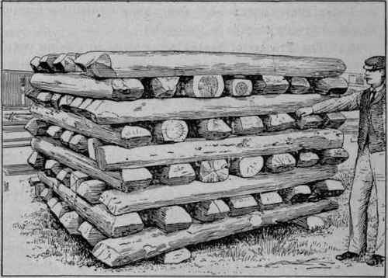
Types of Timber Seasoning
Natural Seasoning:
In the air seasoning or natural seasoning timber is dried by direct action of air, wind and sun.
In this method, the timber logs are arranged one over the other, keeping some space or distance between them for air circulation of fresh air.
Generally this type of seasoning requires few months to over a year, this is very slow process.

Slide 20
Types of Timber Seasoning
(2) ARTIFICIAL SEASONING:
Kiln Seasoning,
(b) Chemical Seasoning,
(c) Electric Seasoning,

Slide 21
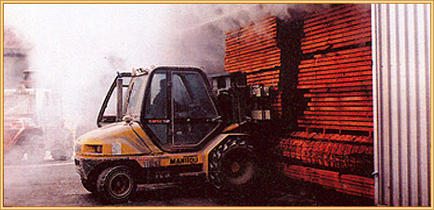
Types of Timber Seasoning
Kiln Seasoning:
In kiln seasoning timber is placed in a chamber with some special heating arrangement.
Heating system should be under control, other wise timber will be crack or wrap .
The time required for this seasoning is 3 to 12 days. This is quick process.

Slide 22
Types of Timber Seasoning
(b) Chemical Seasoning:
In chemical seasoning carbon dioxide, ammonium carbonate or urea are used as agents for seasoning, those are applied in dry state, the inter surface of timber dries first than outer side.
This ensures uniform seasoning.
The time required for this seasoning is 30 to 40 days.

Slide 23
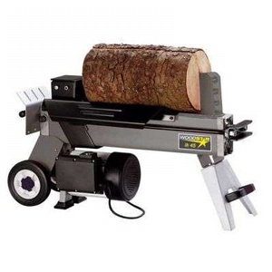
Types of Timber Seasoning
(c) Electric Seasoning:
In this method electric current is passed through the timber logs.
The time required for this seasoning is 05 to 08 hours.

Slide 24
Types of Timber Seasoning
(3) Water Seasoning:
In water seasoning, timber logs are kept immersed whole in the flowing water.
The sap present in timber is washed away. After that logs are taken out from water and are kept in open air, so water present in timber would be dried by air.
The time required for this type of seasoning is 2 to 4 weeks.

Slide 25
USES OF TIMBER
Timber is used in:
Building construction,
Construction of house posts,
Construction of beams,
Construction of bridges,
Construction of piles, poles and railway sleepers

Slide 26
DEFECTS IN TIMBER
Most common defects in timber are:
Heart Shakes
Star Shakes
Cup Shakes
Radial Shakes
Rind Galls
Wind Cracks
Knots
Dead Wood

Slide 27
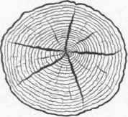
DEFECTS IN TIMBER
Heart Shakes:
These are splits occurring in the centre of the tree. In some timbers, these splits are hardly visible and in some timbers these are quite permanent.
Heart shakes are caused due to shrinkage of interior parts due to age.

Slide 28
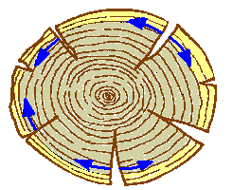
DEFECTS IN TIMBER
(2) Star Shakes:
These are splits which radiate from the centre of the timber or from the bark (outer side), running in the planes of medullary rays.
These occur due to severe frost or scorching heat of the sun.

Slide 29
DEFECTS IN TIMBER
(3) Cup Shakes:
These are curved splits which separate the whole or part of one annual ring from an other.
These are caused due to the unequal growth of the timber.

Slide 30
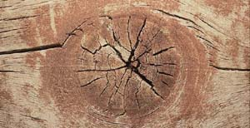
DEFECTS IN TIMBER
(4) Radial Shakes:
These are similar to the star shakes and occur in felled timber when exposed to the sun during seasoning.
Radial shakes are generally irregular, fine and numerous.
In this many splits are appeared.

Slide 31
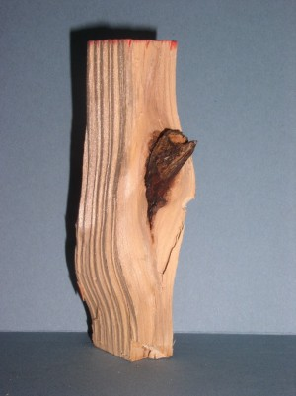
DEFECTS IN TIMBER
(5) Rind Galls:
These are typical enlarged swellings and occur due to branches cut-off.

Slide 32
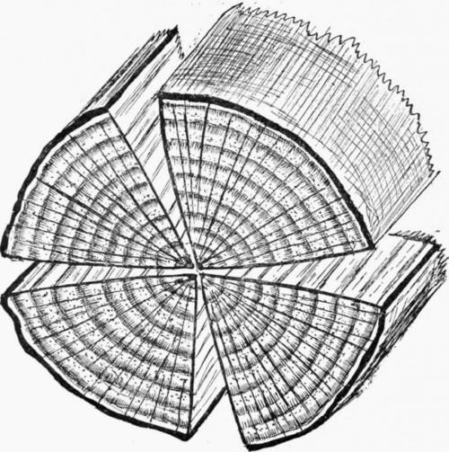
DEFECTS IN TIMBER
(6) Wind Cracks:
These are shakes or splits on the sides of a bark of timber due to shrinkage of exterior surface exposed to atmospheric influence.

Slide 33
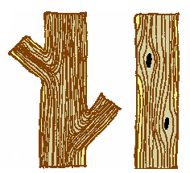
DEFECTS IN TIMBER
(7) Knots:
These are the roots of the small branches of the tree. These are not harmful.

Slide 34
DEFECTS IN TIMBER
(8) Dead Wood:
It is the deficient in strength and weight and is the result of trees being felled after maturity.

Slide 35
Preservation of Timber
It means protecting from fungi and insects attack so that its life is increased. The following are the widely used:
1. Tar
2. Paints
3. Chemical salt
4. Creosote
5. ASCU

Slide 36
Preservation of Timber
1.Tar Treatment:
Hot coal tar is applied to timber with brush. The coating of tar protects the timber from the attack of fungi and insects. It is a cheapest way of protecting timber.
Main disadvantage
Appearance is not good after tar is applied

Slide 37
Preservation of Timber
2. Paints Treatment:
Two to three coats of oil paints are applied on clean surface of wood. The paint protects the timber from moisture. The paint is to be applied from time to time.
Paint improves the appearance of the timber.
Solignum paint is a special paint which protects the
timber.

Slide 38
Preservation of Timber
3. Chemical salt Treatment:
These are the preservatives made by dissolving salts in water. The salts used are copper sulphate, masonry chloride, zinc chloride and sodium fluoride.
After treating the timber with these chemical salt paints and varnishes can be applied to get good appearance.

Slide 39
Preservation of Timber
4. Creosote oil treatment:
Creosote oil is obtained by distillation of coal tar. The seasoned timber is kept in an air tight chamber and air is exhausted.
Then creosote oil is pumped into the chamber. After 1 to 2 hours timber is taken out of the chamber.
5. ASCO Treatment:
This treatment prevents attack from termites. The surface may be painted to get desired appearance.

